Slide 1
UNIT 4 : ADVANCE GIT
INT331

Slide 2
GIT COMPARISON COMMAND
Version control tools are great at many things. One of them is doing comparisons.
In Git, you use the command git diff to compare commits, branches, individual files and more.

Slide 3


Slide 4
Why Do We Use Git Diff?
Being able to make comparisons in your project is extremely useful:
It might help you track down how a bug was introduced.
You can compare two branches to see the result of a future merge.
It’s also possible to see the evolution of a single file through time, so you can, for instance, understand how a recent refactoring affected it.
You can see the changes made since the last commit, to review what will go into the next commit.

Slide 5
How Do We Use Git Diff? A Minimum Example
mkdir diff-demo
cd diff-demo
git init
echo hello > file.txt
git add file.txt
git commit -m "Add text file"
The next step is appending a new line to the end of the file:
echo “more text” >> file.txt
Git diff

Slide 6
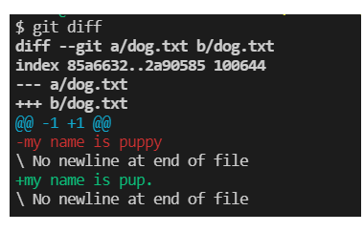
Result of the git diff command

Slide 7
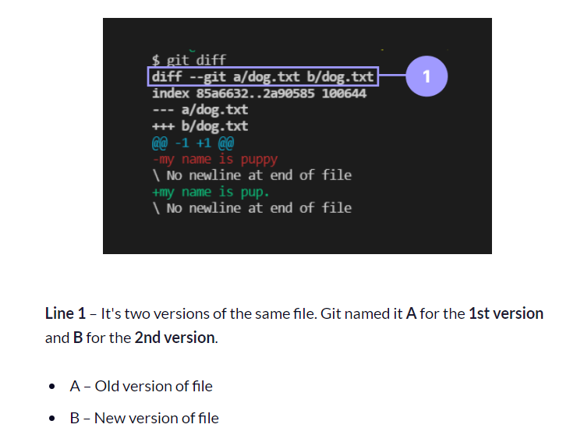
Lets see the result of each line of diff command

Slide 8
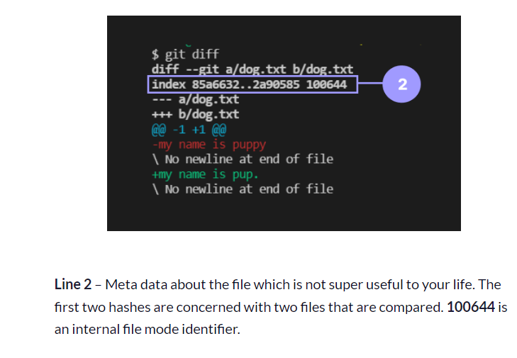

Slide 9
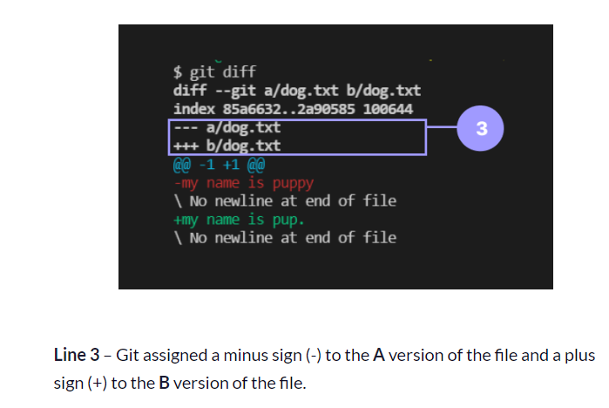

Slide 10
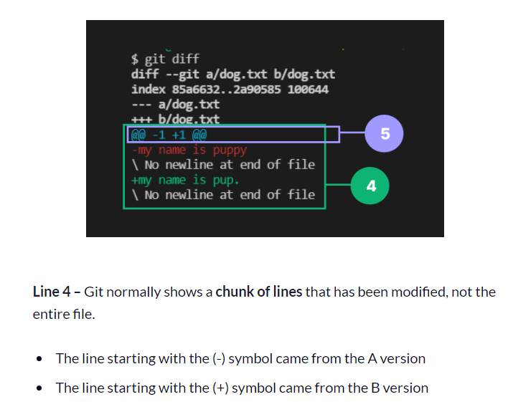

Slide 11
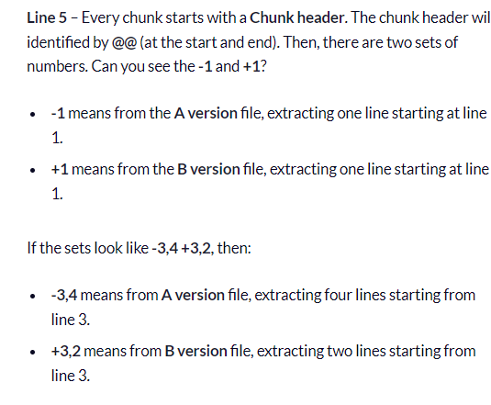

Slide 12
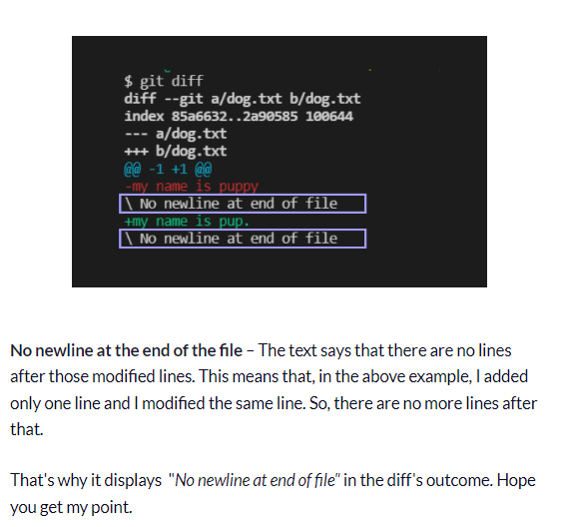

Slide 13
2. How to Compare Staged Changes in Git
Before you commit your changes, you can compare the staged changes with the last commit. You can do this by adding a single flag --staged or --cached.
Let explain it through an example.
First we commit our staged changes in our cat_vs_dog repo.
If you can't remember what we staged, they introduced themselves as kitty and puppy.
There we wanted to make a change – that is, we wished to change the "puppy" to "pup" which is not staged.

Slide 14
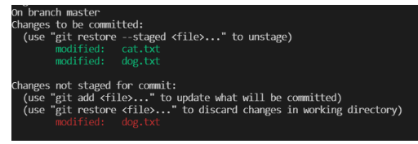
First we commit the staged changes by git commit -m "intro to cat and dog":
The output is :

Slide 15
Run the command
git diff --staged command which lists out the changes between the staged area and your last commit.

Slide 16
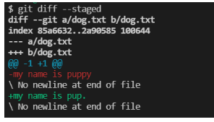
A version – last commit containing the line my name is puppy in dog.txt B version – staging area which differed from the last commit. Like "puppy" to "pup" in dog.txt.

Slide 17
Other variations /options available with diff command
run the git diff HEAD command to compare the both staged and unstaged changes with your last commit.
Also run the git diff <branch_name1> <branch_name2> command to compare the changes from the first branch with changes from the second branch.
Order does matter when you're comparing branches. So diff's outcome will change depending on the order.

Slide 18
3. We can run
git diff <commit_hash> <commit_hash>
the command to compare the changes between two commits. Like branch comparison, order does matter in comparing commits.

Slide 19
We can run the below commands to compare the changes for specific file:
git diff HEAD <file_name>
git diff <file_name>
git diff --staged <file_name> or git diff --cached <file_name>,
git diff <branch_name1> <branch_name2> <file_name>
git diff <commit_hash> <commit_hash> <file_name>

Slide 20
Thank You

